Slide 1
Analysis Challenges
A module in
Agile Business Analysis
workshop
This work is licensed under the
Creative Commons Attribution-ShareAlike 4.0 International License.
To view a copy of this license, visit http://creativecommons.org/licenses/by-sa/4.0/.

Slide 2
Topics
Splitting stories
Story explosion
The Last Responsible Moment
Miscellaneous Challenges
Notes:
1min

Slide 3
Splitting Stories

Slide 4
Splitting Stories
Vertically
Separate error/exception handling
Cross-story concerns
Mixed Priority
User Operations
Complexity
Data validation vs. data entry
Notes:
Split stories vertically like a slice of layered cake
Move error and/or exception handling to a separate story
Remove cross story concerns, such as security, auditing, and performance constraints
Split stories with concepts of mixed priority
Split out user operations, such as create, update, delete
Split out added complexity items such as, searching and filtering
Separate data validation from data entry or editing

Slide 5
Reduce size
Should I split this story?
Too big?
Multiple levels of business value?
Multiple levels of risk?
Dependency
As a System Administrator I want to receive reports showing system usage so I can tune the production environment to maximize performance
11
Develop a threshold for large story sizes
Keep story points within the same order of magnitude
As a System Administrator I want to receive a report on web server usage so I can tune the web server configuration to maximize performance
5
As a System Administrator I want to receive a report on database usage so I can tune the database configuration to maximize performance
7
Notes:
With all of these examples of story splitting, you need to read between the lines of the stories enough to understand the context, but hopefully the scenarios I’ve outlined aren’t too unreasonable.
Splitting a story to distribute the size is by far the most common form of split because the stimulus is so obvious and unambiguous – a story with a large estimate.
Note that the sum of the estimates of the split stories is actually larger than the original one (13 versus 12)! This is also not an uncommon scenario and not all story splits will result in no change to the overall estimate.
Most teams will establish an initial high water mark for estimates, beyond which stories are considered “epics” and should automatically be split. This splitting usually happens (or is at least called out) during the Initiate workshops when estimation is being done.
Low: 2min
High: 5min

Slide 6
Separate value
Should I split this story?
Too big?
Multiple levels of business value?
Multiple levels of risk?
Dependency
As a Call Centre Manager I want call queue statistics so I can report on the efficiency of the call centre team
5
Look in the “so I” phrase of the story” for multiple levels of business value
Need to be a good listener
As a Call Centre Manager I want to see average wait time during peak hours so I can staff the call centre adequately
3
As a Call Centre Manager I want to see average call duration so I can report on the efficiency of the call centre team
2
Notes:
The assumption lurking behind this split is that the Call Centre Manager is more interested in either staffing the call centre adequately or seeing how quickly calls are being completed. This difference in interest translated into a different in business value and may result in one of the split stories being tagged as Must Have whilst the other is a Should Have.
This type of split is a far more difficult one to spot and conduct because it absolutely requires the input of the Customer or SME to make the call on whether there are in fact different levels of business value contained within the story.
Low: 2min
High: 5min

Slide 7
Separate high risk
As a Insurance Actuary I want live metrological data displays so I can adjust insurance calculations in real time
11
Should I split this story?
Too big?
Multiple levels of business value?
Multiple levels of risk?
Dependency
Prove high risk requirements via a technical spike Apply the 80/20 rule to delivering value: 80% of the value can be given with 20% of the effort
As a Insurance Actuary I want daily metrological data displays so I can adjust insurance calculations in real time
5
As a Insurance Actuary I want live metrological data displays so I can adjust insurance calculations in real time
11

Notes:
Another type of split that should be identified during the Initiate workshops are when stories include inherently risky work that should be spiked to validate assumptions around feasibility and/or estimate. The example here shows a situation where the original story was split into a low risk/high risk pair (note the increase in the overall estimate!) with the resulting high risk story being removed from scope, presumably due to the cost involved in delivering it. This is another take on the approach of incrementally delivering the value, from a very low tech solution with checkpoints all the way along the path to give the customer the opportunity to take a simpler, easier solution when one becomes available. The customer won’t always make decisions this way, and it takes some experience to know when and how to apply this skill, but a mature Agile team will always be suggesting cheaper, simpler alternatives to their customer in case one of them will satisfy the core requirement.
Low: 2min
High: 5min

Slide 8
Separate dependencies
As a Call Centre Operator I want to see a claim history (with damage descriptions) from Insurance company A so I can answer queries on previous claims by the same customer
11
Should I split this story?
Too big?
Multiple levels of business value?
Multiple levels of risk?
Dependency
The smaller dependent stories are, the easier they will be to schedule
Highlight dependencies on cards to make the associated risk more visible
As a Call Centre Operator I want to see a claim history so I can answer queries on previous claims by the same customer
3
As a Call Centre Operator I want to retrieve claim history damage descriptions from Insurance company A so I can answer queries on previous claims by the same customer
8
Notes:
Note: “XXX” is the name of the system responsible for collecting descriptions of vehicle damage used by a mythical car insurance company.
Managing dependencies is the bane of IM and PM alike and having the depending/dependent pieces as small as possible makes this job considerably easier. Therefore, splitting stories to isolate the dependency from the remainder of the business functionality is good thinking. In this case, the dependency story is arguably a technical story with little/no inherent business value, which is unfortunate but doesn’t invalidate the reason for the split. This story can now be spiked in isolation if needed (like the previous example) or played in whatever iteration is appropriate to sync up with work that may be required on the XXX system (possibly by another team) to complete the integration.
Low: 2min
High: 5min

Slide 9
Story Growth
Notes:
Aka scope creep or missing requirements.
Your total scope will grow.
You will miss details. You do just enough to get started.
A good contingency number at the beginning is helpful.
Adaptive planning will accommodate this.

Slide 10
Avoiding Story Growth
Business flow
Unclear
Not understandable on its own
Not testable from the UI
Assumptions unclear
Technical categories are ignored
Reports, Security
Integration, data conversions/migrations
Cross-Functional
Exclusions unclear
Often see new functionality sneaking in
Major Objects are not understood
Complexity is missed
Notes:
Visual here of a story exploding into many other stories.
Scope creep.
Top reasons stories / scope explodes
Individual stories do not clearly show business flow
Story is not clear
Not understandable on its own
Isn’t written to be testable from the UI – customer can’t vision the story
Assumptions not clearly defined
Technical categories are ignored
Reports, Security
Integration, data conversions/migrations
Non-Functional
Exclusions are not clear
Often see new functionality sneaking in
Major Objects are not understood
Complexity is missed

Slide 11
Managing Story Growth
Discussion: How to manage story explosion?
Review the original story assumptions and risks
Manage the discussion with the customer
Prioritize the explosion
Re-plan
Notes:
Low: 5min
High: 10min

Slide 12
Last Responsible Moment

Slide 13
What is it?
Not the last minute
Sometimes many iterations before the planned iteration
Notes:
Balancing the cost of making the decision too early with the savings of putting off the decision.

Slide 14
Options
Customer accepts the risk
Defer the card
Split the card
Notes:
Low: 5min
High: 10min

Slide 15



Managing LRM
Notes:
Business Analyst
understand and communicate the last responsible moment for each story issue
get the customer involved well before the last responsible moment
make sure the customer understands the issue/risk for each story
Project Manager
enforce the last responsible moment
Customer
own the risk & make decisions
To defer the story
Accept the risk of developing with great volatility
Do an analysis or development spike for more information
Low: 3min
High: 5min

Slide 16
Other Challenges

Slide 17

Stories too granular
Notes:
Not due to business priorities, but more due to design.
Are your stories changing often during design sessions, or during IPMs?
Causing you to re-write narratives, acceptance criteria.
They may be too detailed…
During inception stories identified are too granular
Are there implementation details?
Do you include seemingly final lists of data requirements?
Low: 2min
High: 4min

Slide 18
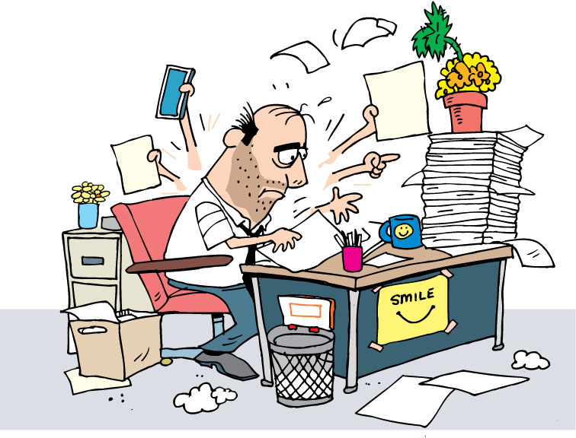
Unavailable customer
Team hours
Proxy?
LRM
Notes:
Is your problem an unavailable customer?
Are you always behind in finishing stories?
Getting enough information to create the narrative?
To conduct a design session?
To present in the IPM?
Original slide bullets:
Set team hours with the customer. This may require early or late hours.
Is there another person who the customer trusts to act as a proxy?
Be clear about the Last Responsible Moment
Low: 2min
High: 3min

Slide 19
Not enough stories ready
Ready
In Progress
In Testing
Done
Enough analysts?
Customer too busy?
Work on defects
Others help?
A
D
F
C
E
B
Notes:
Say we are in the middle of the iteration and the wall looks like this.
There are no stories to be pulled if the devs finish early
or have to swap stories due to technical issues
Not enough stories are ready for developers to start the next iteration
Original slide bullets:
Are there enough analysts to support the dev team?
Is customer too busy to review stories?
Devs can work on defects while waiting for customer to review stories
Can QA or Devs help write Narratives
Low: 2min
High: 5min

Slide 20
Stories are consistently too large
Technical challenges?
Aim for consistent size
Start small, then combine
Notes:
Stories are consistently too big for an iteration
Estimates in IPM are large
Stories are taking longer than estimated
Original bullets from slide
Are there technical challenges causing the developers to over-run their estimates?
Continue to split stories until you arrive at a consistent size
Start with very small stories then combine stories when velocity has stabilized
Low: 2min
High: 3min

Slide 21
Data migration efforts implied
Start with epic
Note dependencies/impacts
Identify to PM
Notes:
During Inception, this should be discussed and included in the release plan
If missed, and caught later….
Original bullets from slide:
Create an epic level story to capture this work
Or better yet, note on stories that may be impacted
Call it out to the Project Manager so they can address it with the client.
Low: 1min
High: 3min

Slide 22
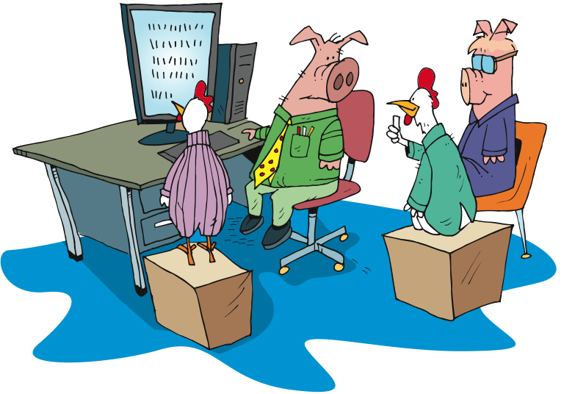
Future users not participating
Separate sessions
Vary schedule
Webinar / other options
MIA
MIA
Notes:
Future users are not participating in showcase to provide feedback
Arrange for separate sessions with users to provide feedback. Encourage customer to be involved in these sessions.
Original bullets from slide:
Arrange for separate sessions with users to provide feedback.
Vary the schedule of showcases to accommodate schedules
Provide webex or other options for participation
Low: 1min
High: 3min

Slide 23
Root cause analysis
Root Cause
Root Cause
How come?
Key users not providing feedback.
So what?
Time
$$
Notes:
Root cause analysis is the process of finding the fire behind the smoke; the dead fish behind the smell, if you will. There are many methods for doing root cause analysis. This notation is not a mandate, merely a suggestion as it emphasises the need to try and quantify the cost of smells, once you have gotten to the root cause.
The lean manufacturing school use the “5 Whys” approach for identifying root causes of problems - we’ll see an example of this technique fairly soon.
Low: 1min
High: 3min

Slide 24
The 5 Whys
We are not getting feedback from key users
Why?
Because they haven’t been identified as part of the project
Why?
Because the project sponsor represents a different group
Can we get sponsorship for that group?
We could, but they can’t commit the time necessary for all the meetings, etc
Why?
Because they weren’t identified as key sponsors
Can we change the sponsorship group so that 50% of the users are represented?
Let’s take that to the executive sponsor.
Notes:
Don’t get too hung up on asking “Why?” exactly 5 times. An experienced applier of this technique will know how deep to question before an actionable root cause is uncovered. It may take more of less than the magical 5 questions suggests.
If you Google “5 whys” and “pigeons” you’ll stumble across a great implementation of this technique well outside the IT domain.
Low: 2min
High: 5min

Slide 25
Review
Splitting stories
Story explosion
The Last Responsible Moment
Miscellaneous Challenges
Notes:
1min

Slide 26
Questions?

